Slide 1
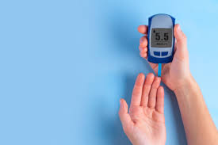
DIABETES PREDICTION
Integrated Prediction Model:
Utilizing Insulin and Age to Assess Diabetes Risk Based on Multivariate Health Factors

Slide 2
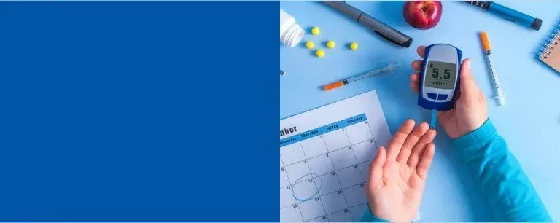
OBJECTIVE
Diabetes risk prediction model that integrates insulin and age with essential health markers including glucose, BMI, skin thickness, and blood pressure. By combining these factors, the model provides a comprehensive assessment of an individual's susceptibility to diabetes.

Slide 3
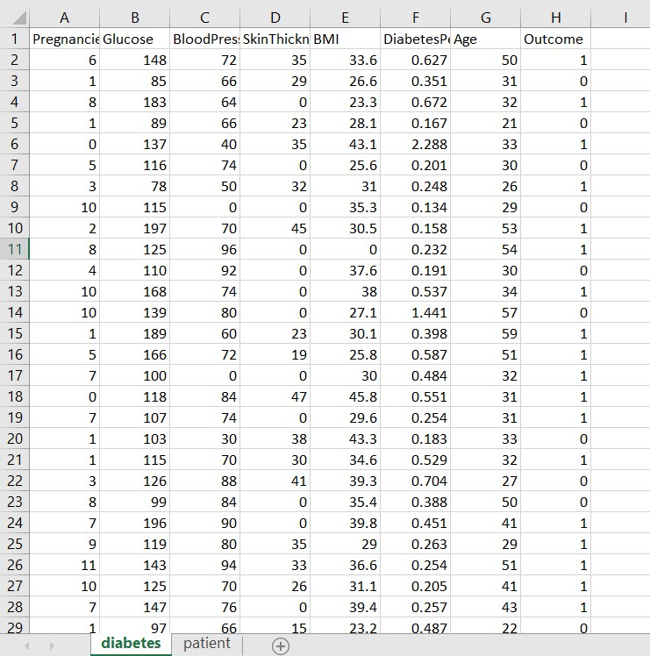
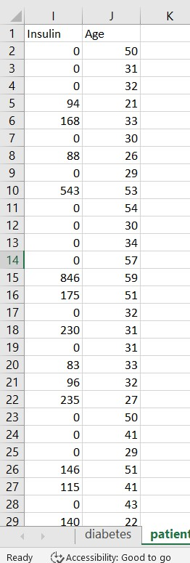
DOWNLOAD THE DATASET

Slide 4
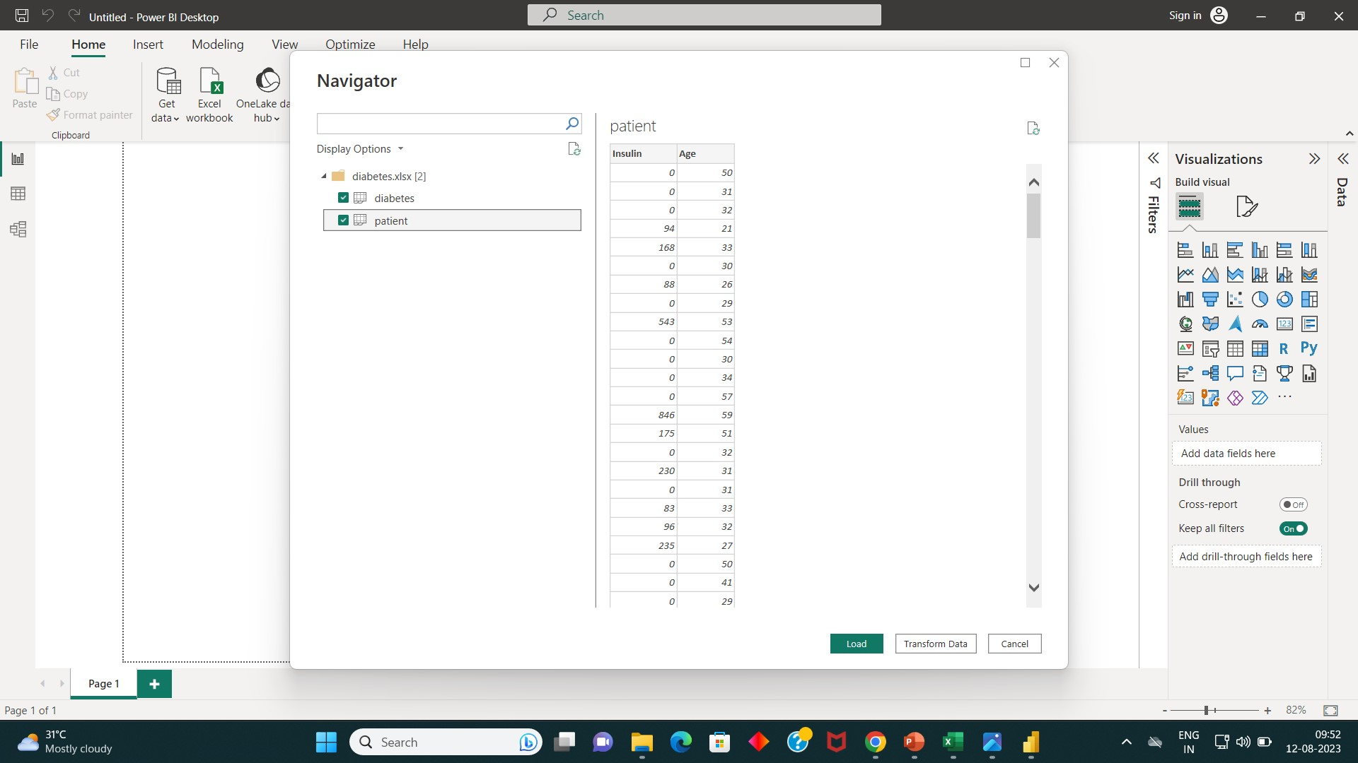
LOAD THE DATASET IN POWER BI

Slide 5
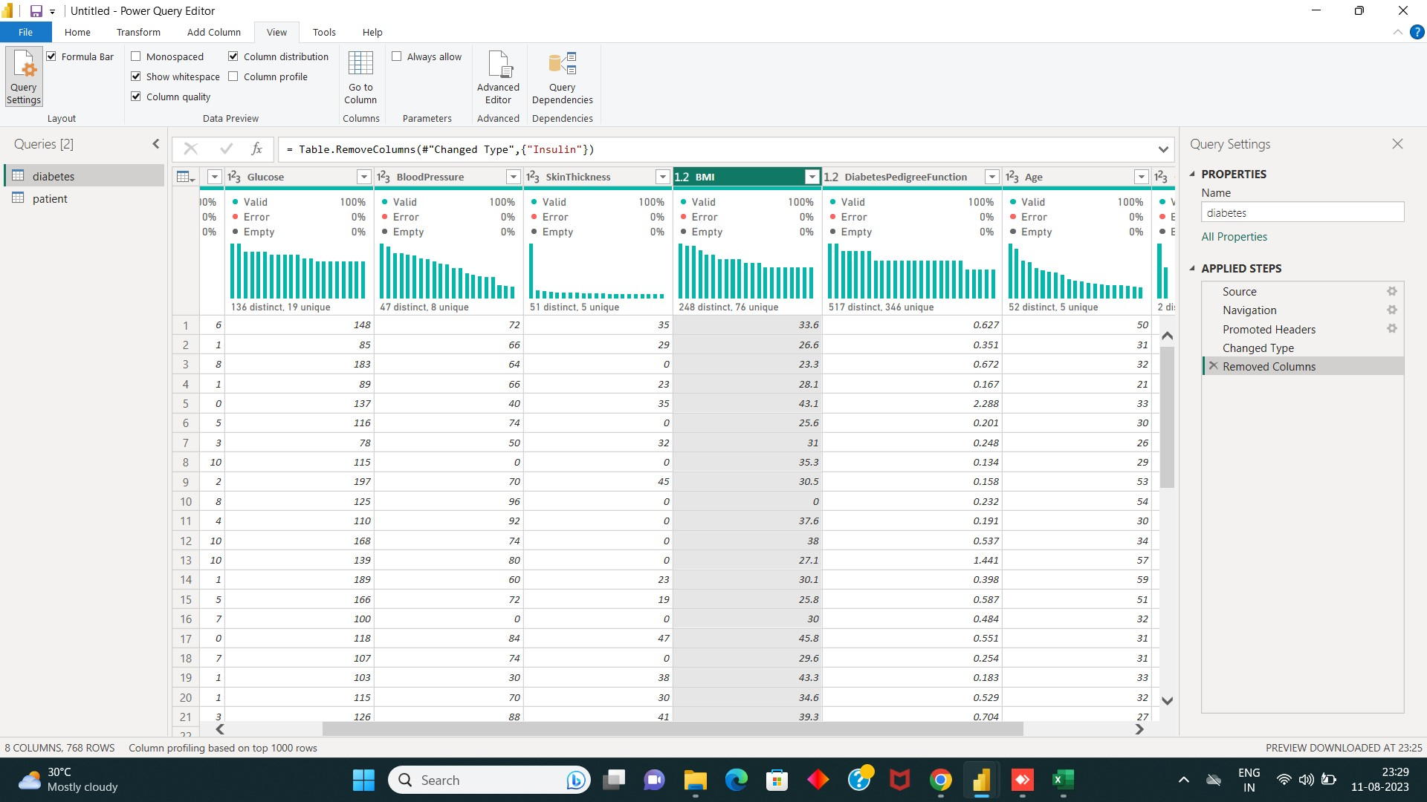
TRANSFORM DATA

Slide 6
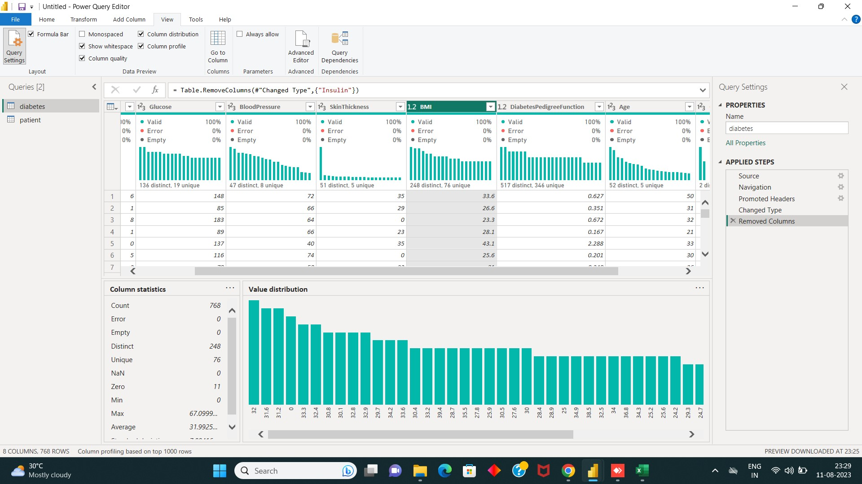

Slide 7
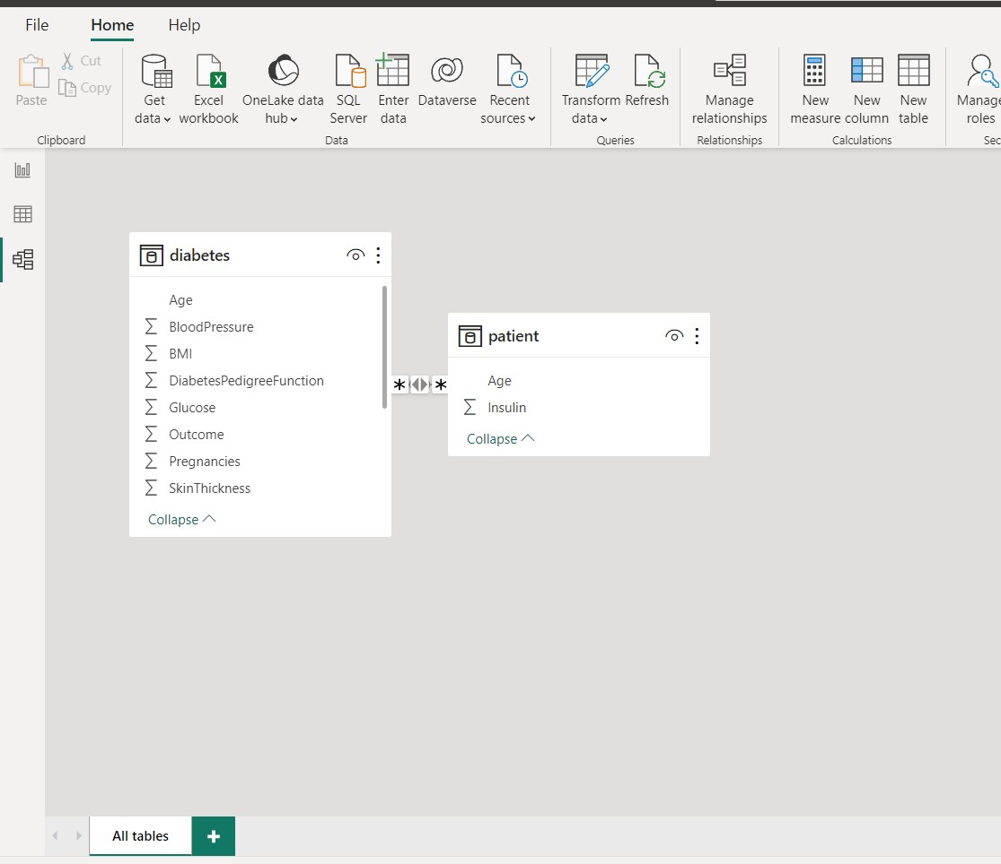
RELATIONSHIP BETWEEN TWO TABLE

Slide 8
DAX CALCULATIONS
CountBloodPressure = COUNT('diabetes'[BloodPressure])
MedianBMI = MEDIAN('diabetes'[BMI])
Sum_BloodPressure = SUM(diabetes[BloodPressure])
Sum_BMI = SUM('diabetes'[BMI])
Sum_Glucose = SUM('diabetes'[Glucose])
Sum_SkinThickness = SUM('diabetes'[SkinThickness])

Slide 9
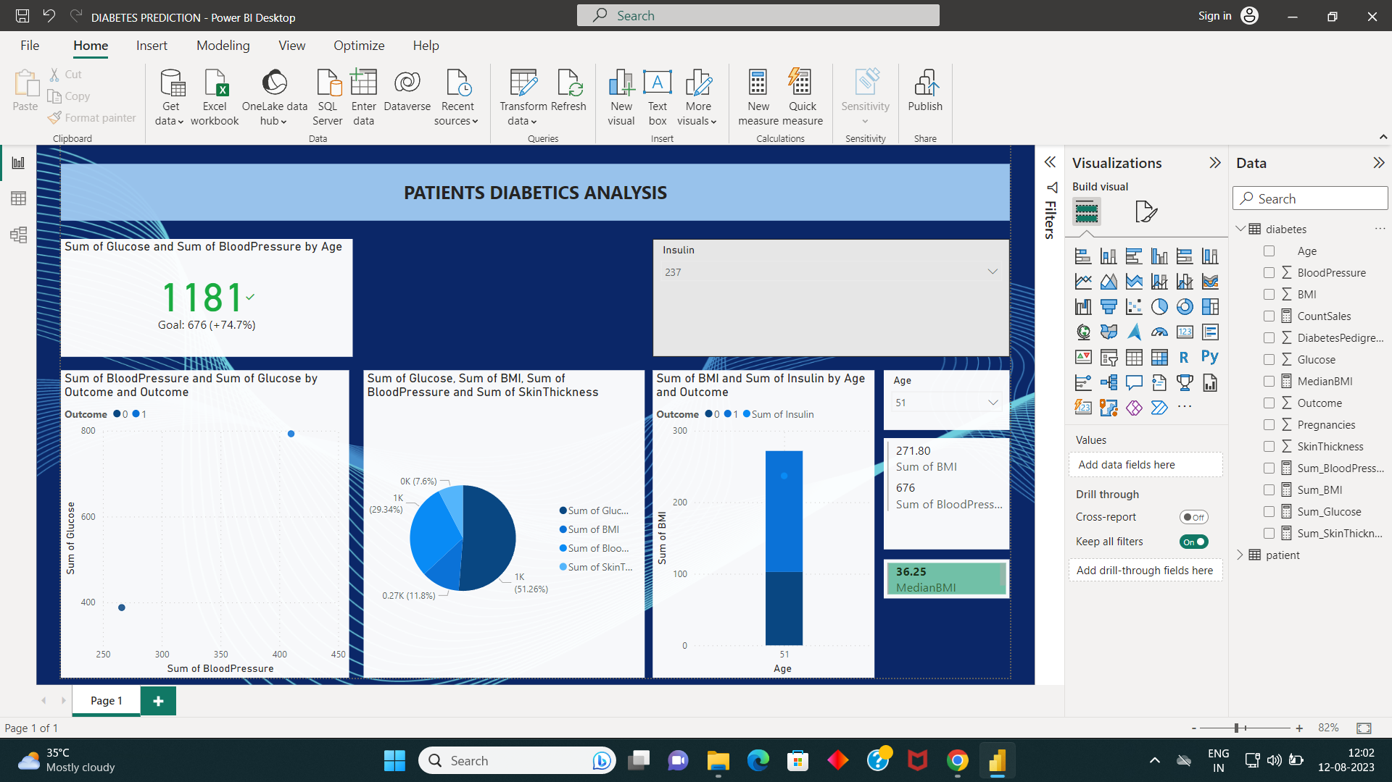
OUTPUT

Slide 10
THANK YOU !
TEAM MEMBERS:
Priyadharshini. M
Adhilakshmi. M
Srilekha. S

